Slide 1
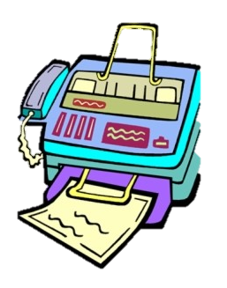
The Fax and the Furious…
The Prescription for Modern Healthcare Data Exchange
Presented by: Raae Wolfram

Slide 2

Agenda
What to look out for…
>Whoami
Background
Legacy of Fax Machines
Security Pitfalls of Fax Machines
Barriers to Care
Digital Transformation
From Fax to Future
Conclusion
Changing Gears from Analog to Digital

Slide 3




>WhoamI
Technology Professional, >15 years
Sr. Product Manager @ Microsoft
New Yorker / Nuyorican
Mom
Star Trek Fan
Had brain surgery in 2016; radiation in 2022
I don’t drive ¯\_(ツ)_/¯
p 3

Slide 4
Why We’re Shifting Lanes
Getting under the hood, to understand our mission…

Slide 5
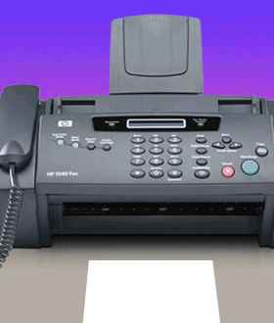
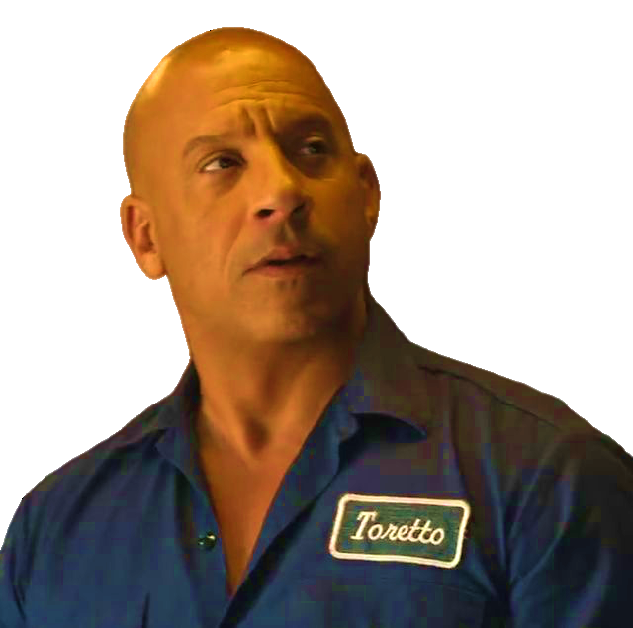
Wtf is a Fax and why tf does it matter
Unpacking the Fax Phenomenon
The genesis of rapid data exchange; still a critical tool in healthcare operations
Why are we at a crossroads?
Antiquated technology and suboptimal medical care
What’s our north star?
A secure healthcare ecosystem, ensuring patient confidentiality and care delivery
Notes:
Fax machines, were once the quarter-mile kings of healthcare data exchange and are now overtaken by digital advancement.
While they sparked a revolution in the '60s, today they open doors to security risks and – arguably most critically – delays in patient care.
This talk spotlights the critical need to switch gears to digital solutions, prioritizing cybersecurity to push patient care across the finish line.

Slide 6




Historical Acceleration
The first fax machine, or facsimile machine, was invented in 1843 by Alexander Bain
Commercial Success in1960s: By 1970s, the fax entered healthcare, marking a new era in medical communication
Fax was the Lifeline of Healthcare Communication, for Quick, Reliable Patient Information Sharing
Notes:
Alexander Bain's 1840s invention – the electric printing telegraph – was the precursor to the fax machine.
Traditional Fax machines transform documents into electronic signals for transmission over phone lines.
Fax machines provide quicker and more secure sharing of medical information, and became prevalent in the 1970s – it took healthcare from paper-bound inefficiency to rapid electronic exchange, and dovetailed with emerging patient privacy standards and reshaping care delivery.
This era set the stage for today's digital communication networks, marking a significant advancement in healthcare's capacity for swift and secure information management.

Slide 7

Endurance Race
Understanding Fax's Tenacity in Healthcare
Established as a standard due to its widespread availability and simplicity
Continues as a legacy system due to entrenched habits and resistance to change
Fax machines are regarded compliant with HIPAA and other privacy laws
Classic Cruise Control
Notes:
Fax machines established a standard in healthcare communications and have been favored for their widespread availability and ostensibly user-friendly nature.
Their continued use as a legacy system is often attributed to well-established routines and a general resistance to overhaul existing practices.
Importantly, traditional fax machines meet the compliance requirements of HIPAA and other privacy legislations, maintaining their status as a viable option for the secure transmission of confidential information.

Slide 8

Turbocharged Trust: Powering Patient Privacy with HIPAA
Health Insurance Portability and Accountability Act of 1996
Established to protect the privacy and security of individuals' medical information
Sets standards for the handling, use, and sharing of Protected Health Information (PHI)
Requires appropriate administrative, physical, and technical safeguards to ensure the confidentiality, integrity, and security of electronic PHI
Mandates that any communication tool, like fax machines, email, or digital messaging platforms, used to transmit PHI must meet HIPAA compliance guidelines
p 8
BSides Puerto Rico - Raae Wolfram
p 8
Notes:
Established in 1996, the Health Insurance Portability and Accountability Act (HIPAA) enforces national standards to protect health information.
It entails 2 core rules: the Privacy Rule, which safeguards individual health information, and the Security Rule, which secures electronic medical records. These 2 rules dictate PHI management across communication and storage in healthcare.
It’s important to grasp HIPAA's influence, as it guides the use of healthcare technology. Whether employing fax machines or digital platforms, compliance is key to protecting patient information and maintaining trust. Vigilance in upholding HIPAA's evolving standards is critical to avoid penalties and reputational damage.
In essence, HIPAA is fundamental in legal compliance as well as in fortifying patient trust through secure information management. Our role in healthcare requires strict adherence to these standards, ensuring every patient data interaction is secure and compliant.

Slide 9
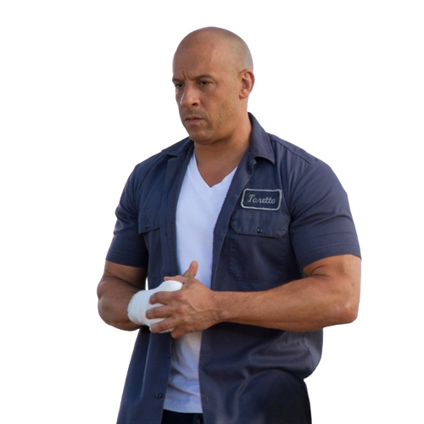
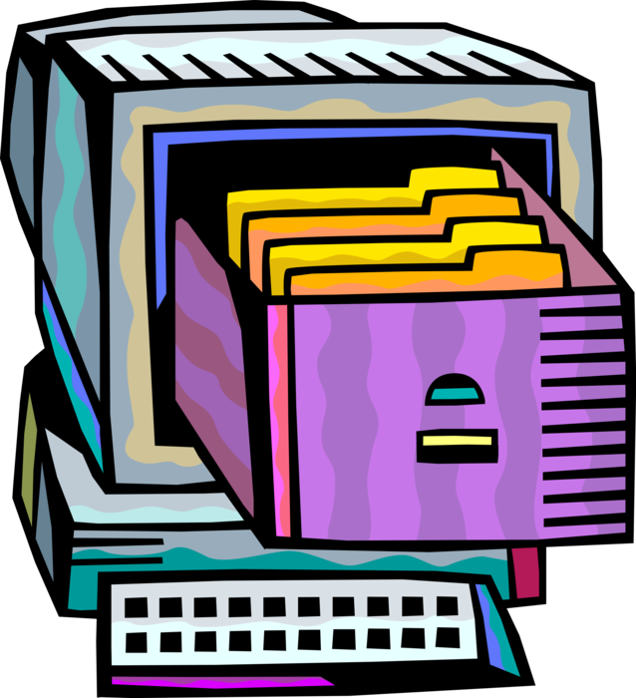
Safety Gears: Traditional Fax in the HIPAA Compliance Lane
Direct Transmission Security
Point-to-Point Communication == Minimal Exposure Risk
Physical Control Over Fax Machines and Output
Administrative Controls
Technical Safeguards
BSides Puerto Rico - Raae Wolfram
Notes:
Traditional faxes rely on direct, point-to-point Public Switched Telephone Network (PSTN) transmission, which minimizes data breach risks due to the absence of intermediaries.
This simplicity aids HIPAA compliance. Healthcare facilities enforce strict physical security and protocols for handling Protected Health Information (PHI), such as secure machine placement and immediate, secure document management post-transmission.
Administrative safeguards are in place to guide the use of fax machines and PHI handling, bolstered by regular staff training on best practices. Despite lacking advanced encryption, the strategic use of physical and procedural safeguards, and confirmation receipts help maintain HIPAA security standards.
Mitigation strategies include consistent audits, defined handling protocols, and additional measures such as cover sheets, ensuring ongoing compliance in fax communications within healthcare.

Slide 10
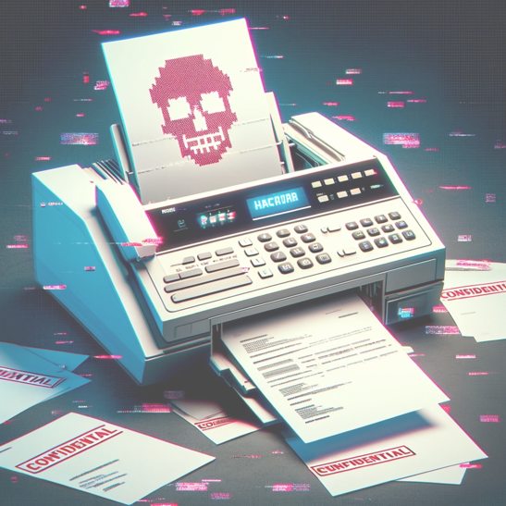

High-Speed Hazards: Pitfalls of Faxes in Healthcare
Security Spinout: Losing Control in the Fast Lane
Speed Traps and Security Gaps
Lack of encryption and secure authentication
Risks of physical document theft in communal areas
Misdialed numbers and machine errors can cause serious information mishaps
Delays in fax communication can lead to slower patient care and treatment
Dependence on fax machines may exclude or inconvenience patients without easy access to fax technology
Notes:
In the landscape of healthcare, fax machines present several vulnerabilities. First, they lack encryption and secure authentication, exposing sensitive patient data during transmission. Additionally, the physical documents they produce are prone to theft or misuse, particularly in common areas.
Human error plays a part too—misdialed numbers or simple machine faults can lead to serious privacy breaches or loss of critical health information. Such errors not only threaten patient privacy but also the quality of care, as delays in fax-based communication can slow down treatment.
Moreover, relying on fax technology can marginalize those without ready access to it, potentially widening the healthcare access gap. As we move towards more inclusive healthcare, recognizing and addressing these pitfalls is crucial.

Slide 11



Roadblocks to Healthcare
Fax in the Rearview
Outrunning the Outdated
Equipment and Operational Constraints
Faxes require specific hardware that may not be readily available to all patients or providers, particularly in remote or underserved areas
Challenge for patients without fax access
Delays in obtaining necessary medical information can affect treatment timelines
?!
Fax technology not immune to Common Vulnerabilities and Exposures (CVEs)
Discovered by Check Point researchers, Faxploit exploits weaknesses in the communication protocol used by fax machines
Through compromised phone lines, attackers can send maliciously crafted images which, when processed by a fax machine, allow them to infiltrate connected networks
Notes:
Fax machines in healthcare are facing twin challenges: accessibility and security. They need specific hardware, not always at hand in remote or under-resourced areas, leading to potential delays in critical medical information flow. These delays can impact patient care, with significant treatment timelines at stake.
Adding to this, fax technology is not bulletproof against cybersecurity threats. Research, including insights from Check Point, has uncovered that fax communication protocols harbor vulnerabilities. Attackers have exploited these, using 'Faxploit' to breach networks through fax machines. They send crafted images that, once processed, could compromise entire connected systems.
The bottom line: As we rely on fax machines, we must be aware of both their physical limitations and their digital weaknesses. It's vital to safeguard our networks and ensure the continuity and integrity of patient care.

Slide 12
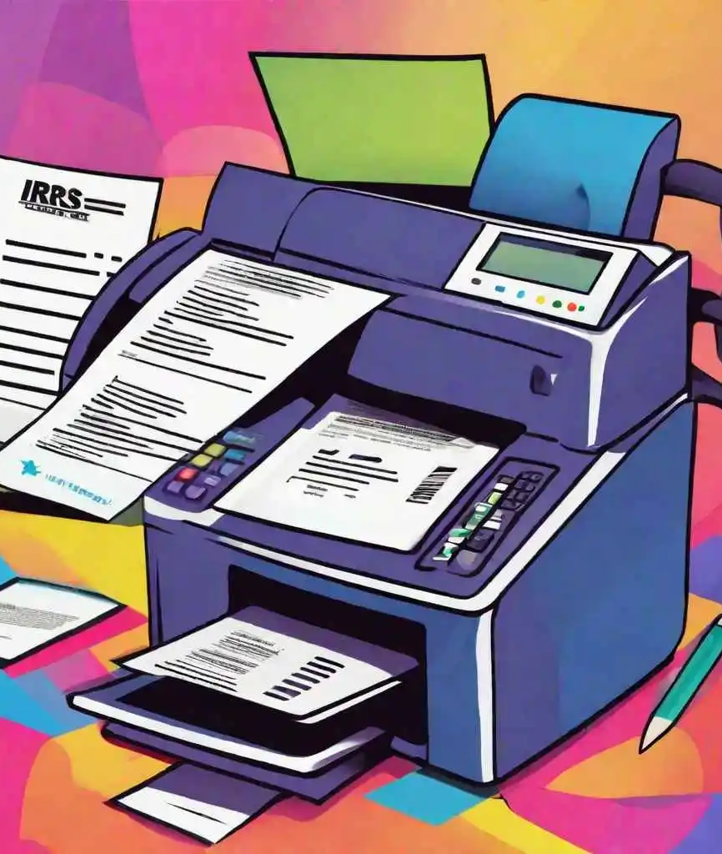

Critical Turn: Unraveling the Fax Vulnerability Route
Vulnerability research by check point revealed fax protocol flaws in HP devices
‘Faxploit’ permits unauthorized code execution via T.30 fax protocol
Intrusion Vector: Malicious Image File Transmission over PSTN
Compromised fax machines decode the image, inadvertently executing embedded malicious payload
The exploit leverages buffer overflows and other exploits at the firmware level
Attackers gain lateral movement capabilities within the network architecture
Potential for data exfiltration and lateral propagation of ransomware or spyware
Notes:
In 2018, Check Point uncovered significant vulnerabilities in the T.30 fax protocol in HP Devices.
These security gaps would allow threat actors to execute unauthorized code through a buffer overflow by transmitting a malicious TIFF image over PSTN, which the fax machine firmware fails to securely process.
Once the malicious code is triggered, the attacker can breach the network perimeter. This creates a conduit for further exploits, such as ransomware deployment or sensitive data extraction. The compromised fax machine becomes a foothold for attackers to navigate through network defenses and access other systems.
Faxes, traditionally viewed as low-tech, are not immune to technical exploits like 'Faxploit', which reveal deep-seated vulnerabilities. Combined with their inherent barriers to timely care, these risks underscore the urgent need for more innovative and secure solutions in healthcare communications.
Check Point: Fax Machines, Networks Vulnerable to Attack (darkreading.com)

Slide 13
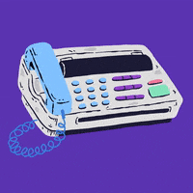

Critical Turn: Unraveling the Fax Vulnerability Route
Fax Mismanagement at St. Luke’s-Roosevelt Hospital Center
A misdirected fax led to a $387,200 HIPAA settlement
Investigation Triggered by Patient Complaint
Previous similar breach nine months earlier without corrective action
Notes:
In recent years, several healthcare organizations in the United States have experienced data breaches due to mismanagement of fax communications. Misdialed numbers, often due to human error, have led to PHI being sent to the wrong recipients, violating patient privacy and exposing hospitals to potential legal and financial repercussions.
St. Luke’s-Roosevelt Hospital's two fax missteps led to a substantial HIPAA settlement, stressing the criticality of handling PHI with utmost care. In one instance, a patient’s highly sensitive health information was erroneously sent to an employer.
Despite this being the second such breach, with the first occurring nine months prior, the hospital had not implemented any corrective measures. The Office of Civil Rights (OCR’s) decisive action on these breaches, despite their small size, underscores a shift towards rigorous enforcement and the necessity for healthcare entities to reinforce their privacy protocols and training to safeguard patient information effectively

Slide 14
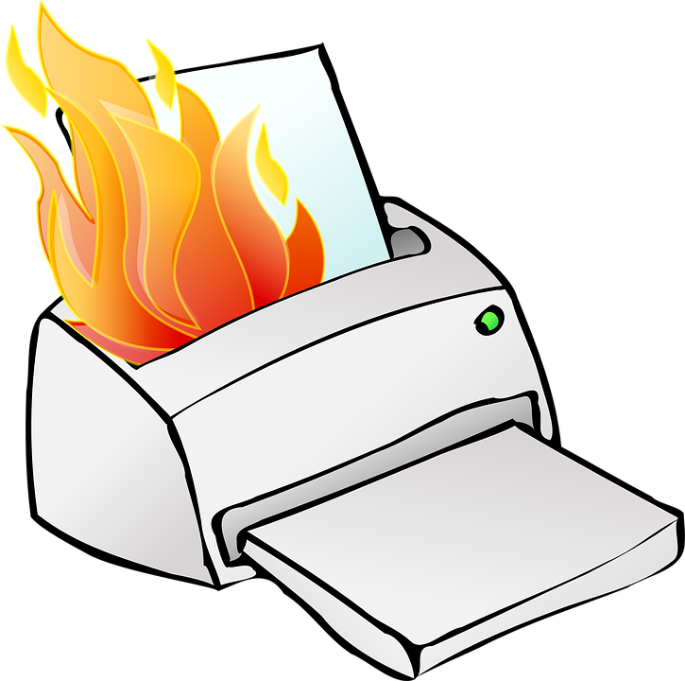

Risky rides, Safe Shifts
Digital Overdrive & Next Gear Necessity – Shifting Up to Safer Healthcare Communication Lanes

Slide 15

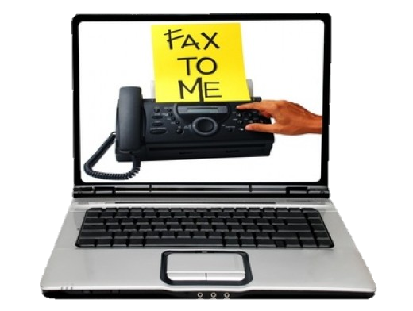
Revving Past the Old Guard: Virtual Fax Takes the Lead
Traditional Faxes
Virtual Faxes
Relies on physical machines, paper, and analog phone lines to transmit documents, which must be manually retrieved and handled
Requires maintenance of hardware, physical space; incurs costs for paper, ink, & telecom services
AKA online fax or e-fax – operates without a physical fax machine, using internet connections to send and receive documents
Documents are transmitted via secure servers and can be accessed through web portals, email, or mobile applications
Virtual fax generally uses encrypted transmission protocols and complies with healthcare regulations like HIPAA for handling sensitive information
Notes:
Traditional fax relies on physical machines, paper, and analog phone lines for document transmission, which then must be manually retrieved and handled. This setup requires ongoing maintenance of hardware, physical space, and incurs costs for essentials like paper, ink, and telecom services.
On the flip side, virtual fax, also known as online fax or e-fax, operates entirely in the digital realm. It doesn't require a physical fax machine but instead uses internet connections to send and receive documents. These documents are transmitted via secure servers and can be accessed through web portals, email, or mobile applications.
One significant advantage of virtual fax is its adherence to strict security protocols. It generally uses encrypted transmission methods, ensuring data privacy and compliance with healthcare regulations such as HIPAA when handling sensitive information.
Now, let's address the practical usage of virtual fax. While it's predominantly utilized in provider-to-provider communications, where healthcare entities exchange medical records, lab results, and other clinical documents securely, it's not typically a tool directly used by patients for communication

Slide 16
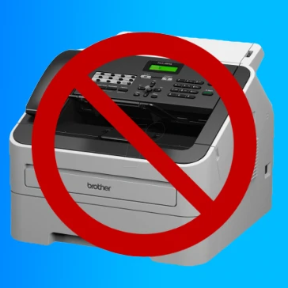

The Need for Digital Overhaul
Digital platforms offer robust security protocols, including multi-factor authentication and end-to-end encryption
Automated digital workflows minimize human error and enhance data integrity and traceability
Facilitate real-time data exchange, equipped with advanced threat detection and response mechanisms
Support scalable security measures, adapting to evolving cyber threats and regulatory requirements
p 16
BSides Puerto Rico - Raae Wolfram
Notes:
Digital platforms bring a wealth of benefits to healthcare data exchange. They offer robust security protocols like multi-factor authentication and end-to-end encryption, ensuring the confidentiality and integrity of sensitive information.
One of the key advantages of digital workflows is their ability to minimize human error. Automation enhances data integrity and traceability, reducing the risk of mistakes and ensuring accurate record-keeping.
These platforms also facilitate real-time data exchange, equipped with advanced threat detection and response mechanisms. This means that potential security threats are identified and addressed swiftly, minimizing the impact of cyber incidents.
Moreover, digital platforms support scalable security measures. They can adapt to evolving cyber threats and regulatory requirements, providing a flexible and resilient framework for healthcare organizations to safeguard patient data effectively

Slide 17

A Turbocharged Upgrade for Healthcare Data Protection
Transitioning from traditional faxing to secure electronic methods is crucial for modernizing healthcare data exchange:
Secure messaging platforms offer encrypted communication channels for sharing sensitive patient information
Integrating Electronic Health Records (EHR) with secure communication systems streamlines data exchange and enhances interoperability
Health Information Exchange (HIE) Messaging platforms facilitate secure and standardized exchange of patient health information among healthcare entities
Fueling Efficiency and Security
Notes:
Let's explore the solutions offered by secure electronic methods:
Secure messaging platforms provide encrypted communication channels, ensuring the safe sharing of sensitive patient information among healthcare professionals. This significantly reduces the risk of data breaches and improves confidentiality.
Integrating Electronic Health Records (EHR) with secure communication systems streamlines data exchange and enhances interoperability. Healthcare providers can access patient data securely and in real-time, leading to more informed decision-making and improved patient care.
Health Information Exchange (HIE) Messaging platforms play a crucial role in securely and uniformly exchanging patient health information among different healthcare entities. This promotes efficient and compliant data sharing, reducing administrative burdens and enhancing overall healthcare coordination.
By transitioning to these secure electronic methods, healthcare organizations can overcome the limitations and risks associated with traditional faxing. They can improve data security, streamline workflows, enhance interoperability, and ultimately deliver better patient care.
Adopting secure electronic methods is not just about modernizing healthcare data exchange; it's about ensuring patient privacy, data integrity, and efficient healthcare delivery.

Slide 18

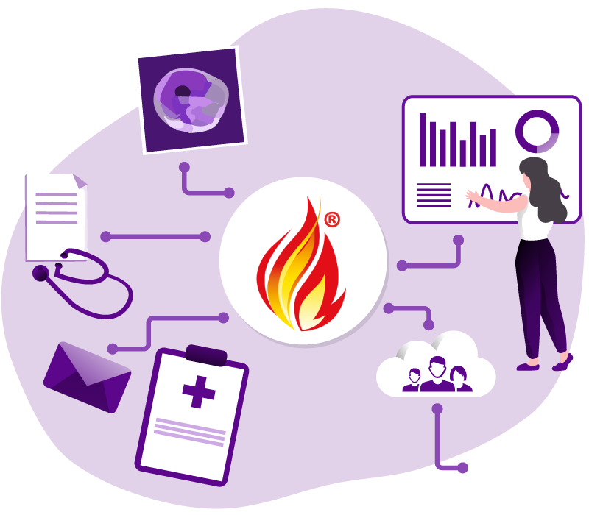
HIE and FHIR: Redefining Data Speedways in Healthcare
Fast Healthcare Interoperability Resources (FHIR) is a standardized data format for exchanging electronic health records (EHRs) securely
HIE and FHIR offer secure electronic data exchange, reducing reliance on paper-based methods
Supports real-time data access, interoperability, and improved care coordination
Notes:
HIE enables seamless sharing of patient records among healthcare providers, leading to improved care coordination and ultimately enhancing patient outcomes. Patients benefit from streamlined processes, reduced paperwork, and quicker access to comprehensive medical information, leading to more informed and personalized care decisions.
FHIR, on the other hand, promotes interoperability between different healthcare systems and applications. This means that patients can experience smoother transitions between healthcare providers, with their medical data seamlessly accessible across various platforms. Real-time access to structured clinical data empowers patients to actively participate in their healthcare journey, leading to better engagement and outcomes.
While patients may not directly use HIE or FHIR frameworks themselves, they are the ultimate beneficiaries of these technologies. The enhanced data exchange and interoperability facilitated by HIE and FHIR contribute significantly to improving patient care experiences and outcomes.

Slide 19

Turning Paper Trails into Lifelines
Role of fax machines evolves from primary to supplementary
While suboptimal as business as usual, fax machines can still play a role in maintaining operational resilience
Cater to specific instances where immediate and secure document transmission is essential but digital alternatives are unavailable
p 19
BSides Puerto Rico - Raae Wolfram
p 19
BSides Puerto Rico - Raae Wolfram
Notes:
While they have been longstanding tools, it's important to acknowledge their limitations and consider whether they are becoming obsolete.
In certain critical moments, such as during system failures or cyberattacks, fax machines can still play a role as backup communication tools. They offer immediate delivery of critical documents when digital systems may be compromised.
Similarly, in edge cases like remote or underserved areas with limited digital infrastructure, fax machines can be reliable due to their established infrastructure and ease of use.
However, despite these specific use cases, it's crucial to recognize the challenges that come with fax machines. The lack of encryption poses risks for sensitive patient information, and manual processes can lead to delays and errors.
Moreover, as healthcare evolves towards digital transformation, fax machines may not meet the scalability and interoperability needs of modern healthcare systems. Integrating them into emergency plans and providing training can enhance their effectiveness, but it's essential to also explore more secure and efficient digital communication methods.
In conclusion, while fax machines may have niche roles in certain scenarios, their overall relevance in modern healthcare is diminishing. As we move towards digital solutions that offer better security, efficiency, and interoperability, it's important to evaluate the continued use of fax machines in healthcare. Thank you.

Slide 20


Thank You
Raae Wolfram
digitalraae[at]gmail[dot]com

